Slide 1
ONE-INNOVATION HUB ARTIFICIAL INTELLIGENCE CLASS
TOPIC: SUPPORT VECTOR MACHINE (SVM)

Slide 2
INTRODUCTION
A support vector machine (SVM) is machine learning algorithm that analyzes data for classification and regression analysis.
SVM is a supervised learning method that looks at data and sorts it into one of two categories.
An SVM outputs a map of the sorted data with the margins between the two as far apart as possible.

Slide 3
It is trained with a series of data already classified into two categories, building the model as it is initially trained.
The task of an SVM algorithm is to determine which category a new data point belongs in.
This makes SVM a kind of non-binary linear classifier.

Slide 4
APPLICATIONS OF SVM
Text and hypertext classification
Image classification
Recognizing handwritten characters
Biological sciences, including protein classification

Slide 5
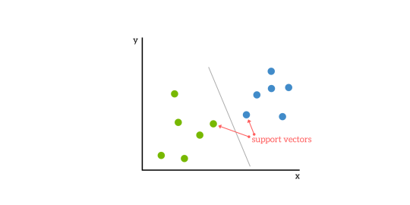
PRINCIPLES OF SVM
SVMs are based on the idea of finding a hyperplane that best divides a dataset into two classes, as shown in the image below

Slide 7
TERMINOLOGIES IN SVM
1 . Support Vectors: Support vectors are the data points nearest to the hyperplane, the points of a data set that, if removed, would alter the position of the dividing hyperplane.
Due of this, they can be considered the critical elements of a data set.

Slide 8
2. Hyperplane: An hyperplane as a line that linearly separates and classifies a set of data.
Intuitively, the further from the hyperplane our data points lie, the more confident we are that they have been correctly classified.
We therefore want our data points to be as far away from the hyperplane as possible, while still being on the correct side of it.

Slide 9
2. Hyperplane: An hyperplane as a line that linearly separates and classifies a set of data.
Intuitively, the further from the hyperplane our data points lie, the more confident we are that they have been correctly classified.
We therefore want our data points to be as far away from the hyperplane as possible, while still being on the correct side of it.

Slide 10
How do we find the right hyperplane?
3. Margin: The distance between the hyperplane and the nearest data point from either set is known as the margin.
The goal is to choose a hyperplane with the greatest possible margin between the hyperplane and any point within the training set, giving a greater chance of new data being classified correctly.

Slide 11
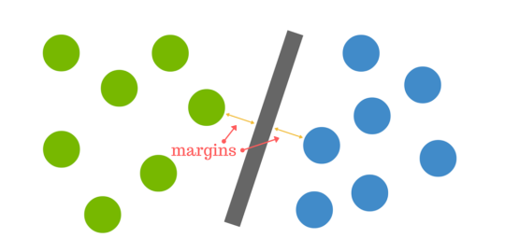

Slide 12
Let’s imagine we have two tags: red and blue, and our data has two features: x and y.
We want a classifier that, given a pair of (x,y) coordinates, outputs if it’s either red or blue.
We plot our already labeled training data on a plane:

Slide 13
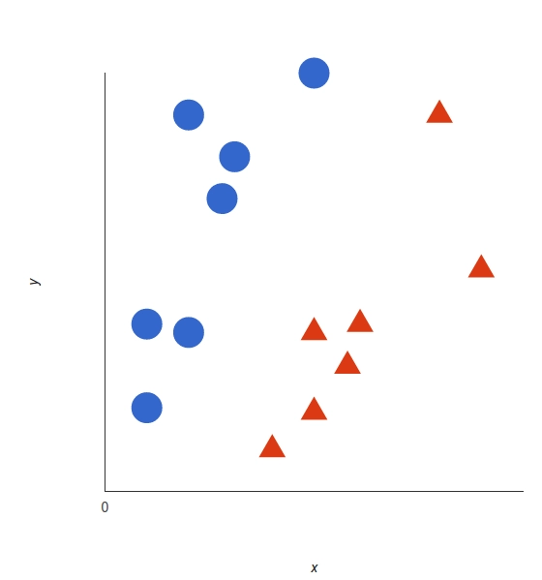

Slide 14
A support vector machine takes these data points and outputs the hyperplane (which in two dimensions it’s simply a line) that best separates the tags.
This line is the decision boundary: anything that falls to one side of it we will classify as blue, and anything that falls to the other as red.

Slide 15
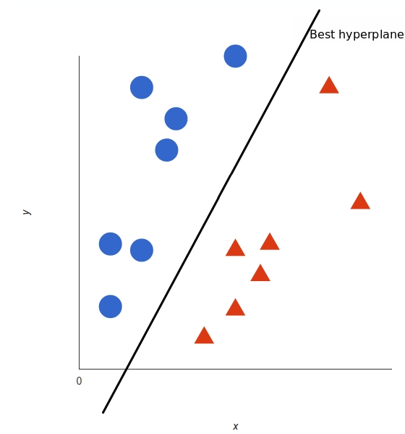

Slide 16
But, what exactly is the best hyperplane? For SVM, it’s the one that maximizes the margins from both tags.
In other words: the hyperplane (remember it's a line in this case) whose distance to the nearest element of each tag is the largest.
In non-linear cases, the hyperplane is n-1 dimension

Slide 17
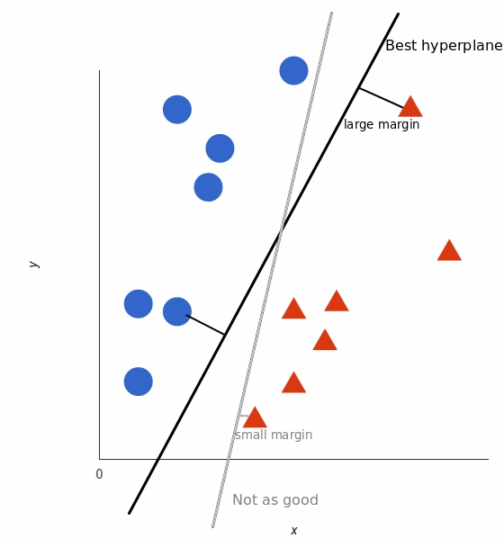
Determining the best hyperplanes

Slide 18
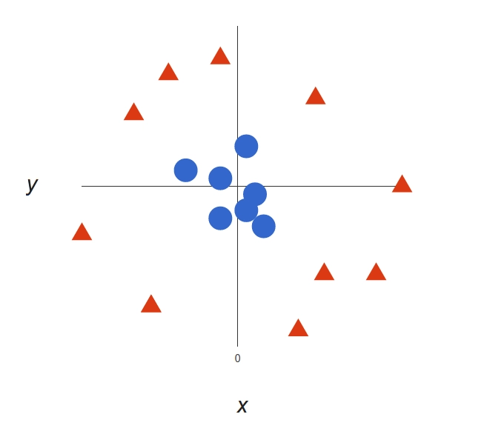
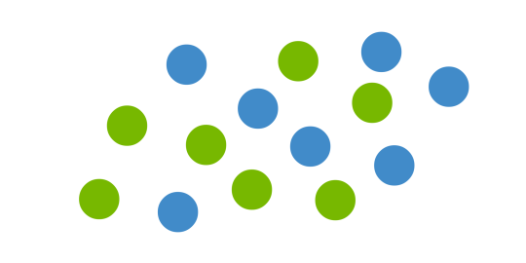
What happens when there is no clear hyperplane?

Slide 19
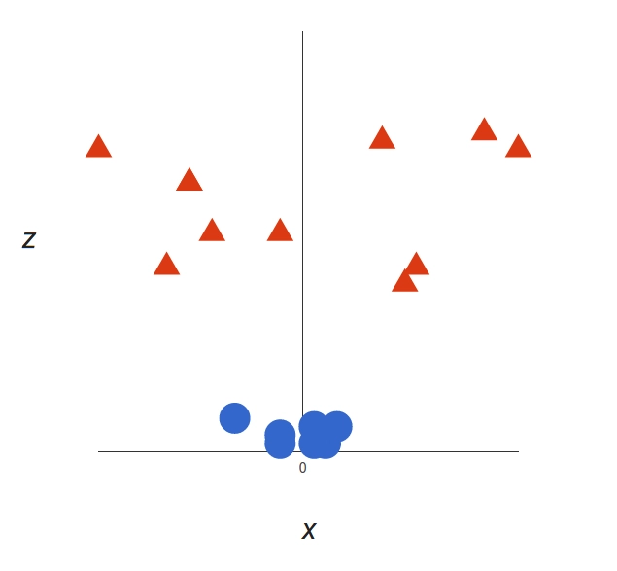
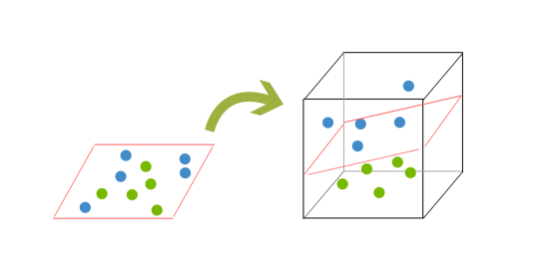
THE KERNELING TRICK

Slide 20
PROS & CONS OF SVM
Accuracy
Works well on smaller cleaner datasets
It can be more efficient because it uses a subset of training points
Cons
Isn’t suited to larger datasets as the training time with SVMs can be high
Less effective on noisier datasets with overlapping classes

